Slide 1
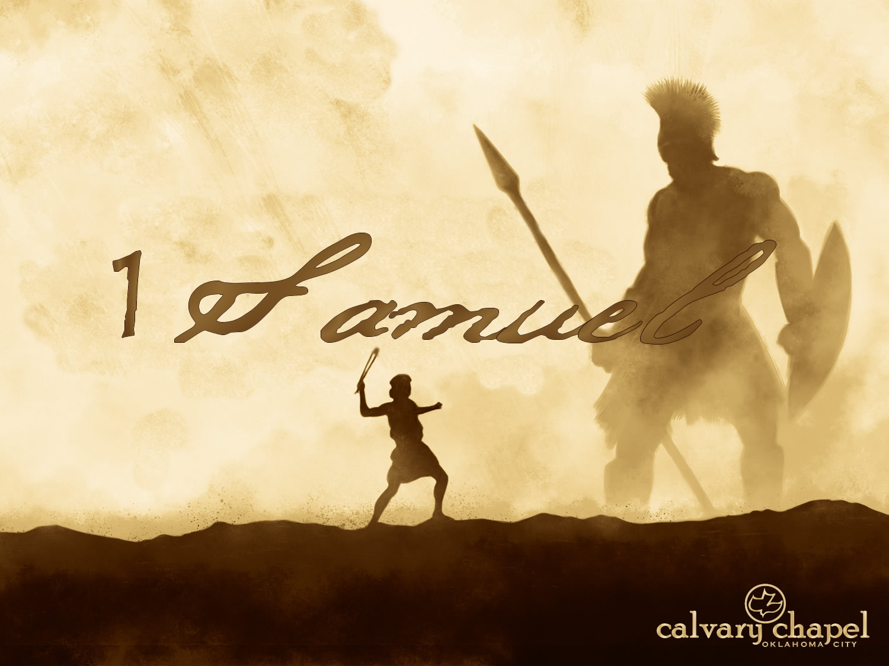

A CD of this message will be available (free of charge) immediately following today's message
This message will be available via podcast later this week at calvaryokc.com
23-24

Slide 2
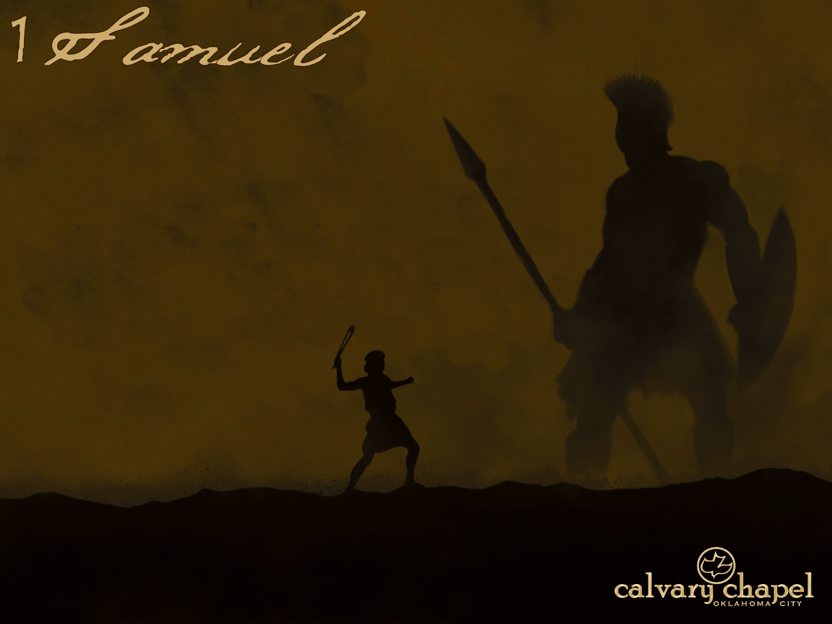
23-24
Keilah ~ fortress

Slide 3
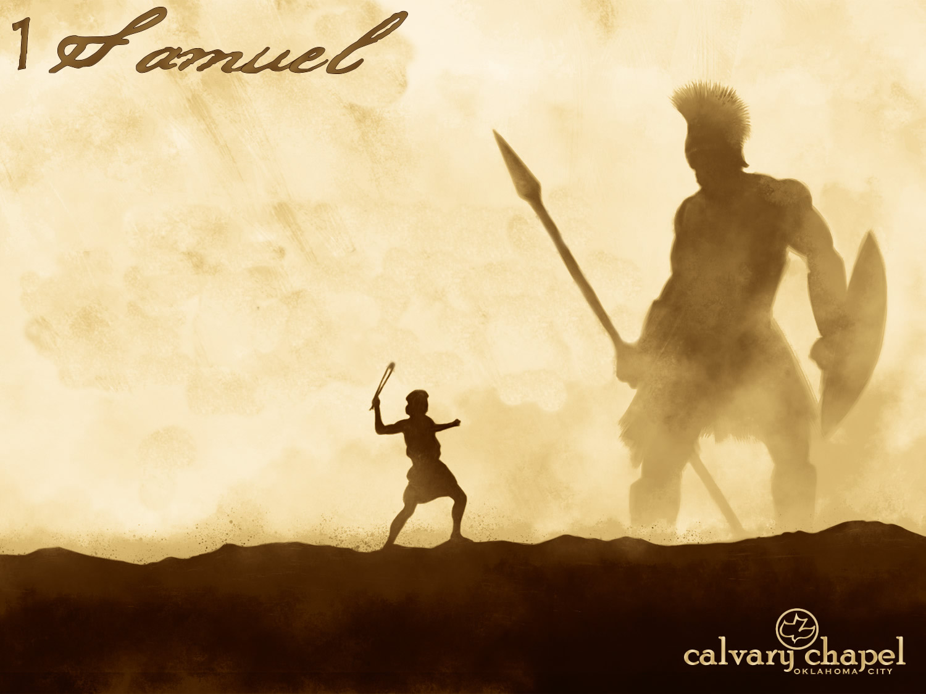
23-24

Slide 4
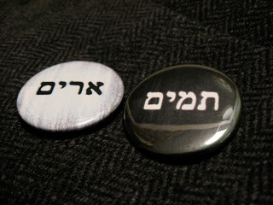
23-24
Urim
Lights
Thummim
Perfections

Slide 5
23-24
F. B. Meyer ~ "Each child of God has his own Urim and Thummim stone, which is a conscience void of offense, a heart cleansed in the blood of Christ, a spiritual nature which is pervaded and filled by the Holy Spirit of God."

Slide 6
23-24

Slide 7
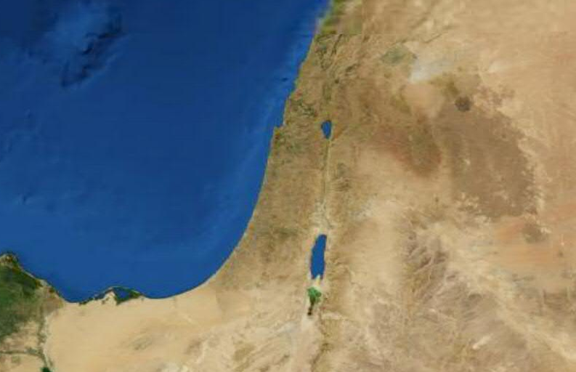
23-24
Wilderness of Ziph
Adullam
En-gedi

Slide 8
23-24

Slide 9
23-24
In the woods ~ NIV, at Horesh

Slide 10
23-24

Slide 11
23-24
George Eliot – "Oh the comfort, the inexpressible comfort, of feeling safe with a person, having neither to weigh thoughts nor measure words, but to pour them all out just as they are, chaff and grain together, knowing that a faithful hand will take and sift them, keep what is worth keeping, and then, with the breath of kindness blow the rest away."

Slide 12
23-24

Slide 13
23-24
Psalm 54 ~ To the Chief Musician. With stringed instruments. A Contemplation of David when the Ziphites went and said to Saul, “Is David not hiding with us?”
¹ Save me, O God, by Your name,
And vindicate me by Your strength.
² Hear my prayer, O God;
Give ear to the words of my mouth.
³ For strangers have risen up against me,
And oppressors have sought after my life;
They have not set God before them.
Selah

Slide 14
23-24

Slide 15
23-24
Attend to his needs
KLV, cover his feet
NIV, NASB ~ relieve himself
TLB ~ go to the bathroom
Ps. 40:2 (KJV) ~ He brought me up also out of an horrible pit, out of the miry clay, and set my feet upon a rock, and established my goings.

Slide 16
23-24

Slide 17
23-24
Napoleon - "God is on the side with the heaviest artillery"
French forces:
Anglo/allied forces:
48,000 infantry
50,000 infantry
14,000 cavalry
11,000 cavalry
7,000 artillery
6,000 artillery
250 guns
150 guns
69,000 troops
67,000 troops
Thomas á Kempis - "Man proposes, God disposes."

Slide 18
23-24

Slide 19
23-24
2 Cor. 7:10 ~ For godly sorrow produces repentance leading to salvation, not to be regretted; but the sorrow of the world produces death.

Slide 20
23-24

